Slide 1
Introduction to the
Diodes
PN Junction, Zener, LED

Slide 2
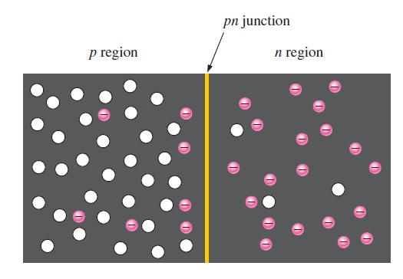
THE PN JUNCTION
If a piece of intrinsic silicon is doped so that part is n-type and the other part is p-type, a pn junction forms at the boundary between the two regions and a diode is created, as indicated in Figure 1–19(a). The p region has many holes (majority carriers) from the impurity atoms and only a few thermally generated free electrons (minority carriers). The n-region has many free electrons (majority carriers) from the impurity atoms and only a few thermally generated holes (minority carriers).

Slide 3
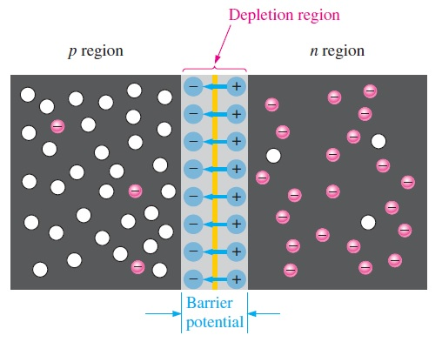
Formation of the Depletion Region
When the pn junction is formed, the n region loses free electrons as they diffuse across the junction. This creates a layer of positive charges (pentavalent ions) near the junction. As the electrons move across the junction, the p region loses holes as the electrons and holes combine. This creates a layer of negative charges (trivalent ions) near the junction. These two layers of positive and negative charges form the depletion region
The term depletion refers to the fact that the region near the pn junction is depleted of charge carriers (electrons and holes) due to diffusion across the junction. Keep in mind that the depletion region is formed very quickly and is very thin compared to the n-region and p region.

Slide 4
Barrier Potential
The potential difference of the electric field across the depletion region is the amount of voltage required to move electrons through the electric field. This potential difference is called the barrier potential and is expressed in volts
The barrier potential of a pn junction depends on several factors, including:
the type of semiconductive material
the amount of doping
the temperature.
The typical barrier potential is approximately 0.7 V for silicon and 0.3 V for germanium at 25C

Slide 5
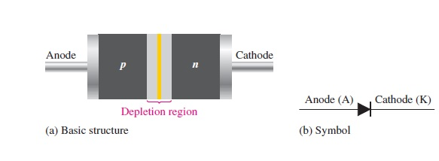
The Diode
a diode is made from a small piece of semiconductor material, usually silicon, in which half is doped as a p region and half is doped as an n region with a pn junction and depletion region in between. The p region is called the anode and is connected to a conductive terminal. The n region is called the cathode and is connected to a second conductive terminal.

Slide 6
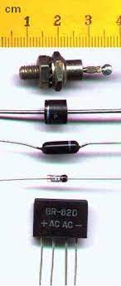
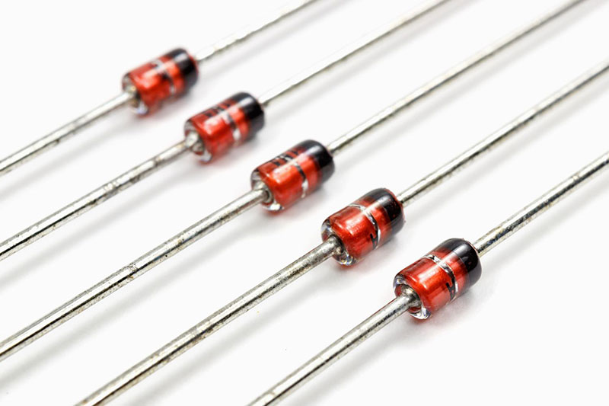

Slide 7
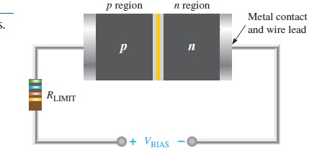
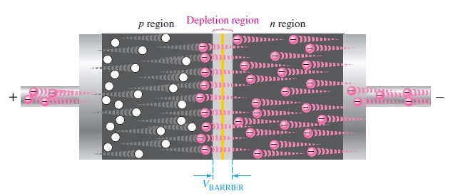
Forward Bias
To bias a diode, you apply a dc voltage across it. Forward bias is the condition that allows current through the pn junction

Slide 8
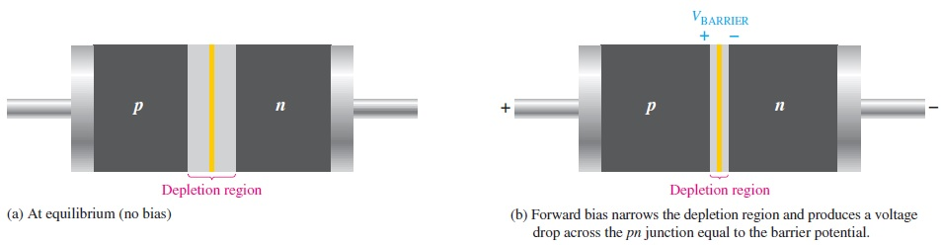
The Effect of Forward Bias on the Depletion Region
As more electrons flow into the depletion region, the number of positive ions is reduced. As more holes effectively flow into the depletion region on the other side of the pn junction, the number of negative ions is reduced. This reduction in positive and negative ions during forward bias causes the depletion region to narrow

Slide 9
The Effect of the Barrier Potential During Forward Bias
Recall that the electric field between the positive and negative ions in the depletion region on either side of the junction creates an “energy hill” that prevents free electrons from diffusing across the junction at equilibrium. This is known as the barrier potential.
The energy that the electrons require in order to pass through the depletion region is equal to the barrier potential. In other words, the electrons give up an amount of energy equivalent to the barrier potential when they cross the depletion region
This energy loss results in a voltage drop across the pn junction equal to the barrier potential (0.7 V)

Slide 10
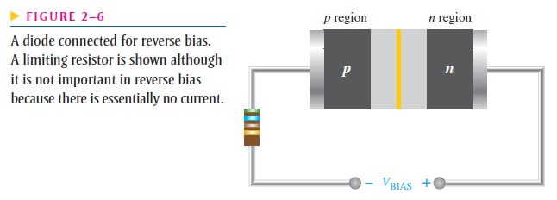
Reverse Bias
Notice that the positive side of VBIAS is connected to the n region of the diode and the negative side is connected to the p region. Also note that the depletion region is shown much wider than in forward bias or equilibrium.

Slide 11
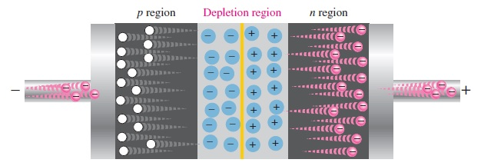
Effect of Reverse Bias on Depletion Region
Because unlike charges attract, the positive side of the bias-voltage source “pulls” the free electrons, which are the majority carriers in the n region, away from the pn junction. As the electrons flow toward the positive side of the voltage source, additional positive ions are created. This results in a widening of the depletion region and a depletion of majority carriers.
As more of the n and p regions become depleted of majority carriers, the electric field between the positive and negative ions increases in strength until the potential across the depletion region equals the bias voltage, VBIAS. At this point, the transition current essentially ceases except for a very small reverse current that can usually be neglected.

Slide 12
Reverse Breakdown
However, if the external reverse-bias voltage is increased to a value called the breakdown voltage, the reverse current will drastically increase. This is what happens. The high reverse-bias voltage imparts energy to the free minority electrons so that as they speed through the p region, they collide with atoms with enough energy to knock valence electrons out of orbit and into the conduction band. The newly created conduction electrons are also high in energy and repeat the process.
The multiplication of conduction electrons is known as the avalanche effect, and reverse current can increase dramatically
When the reverse current is not limited, the resulting heating will permanently damage the diode.

